Slide 2

TECHNOLOGICAL INSTITUTE OF THE PHILIPPINES
ITE 001A
Programming Concepts Overview

Slide 3
Learning Objectives
Value the historical development of computer programming
Examine the programming process of C++.
Discover the components of C++ programming.
Analyze the declaration of keywords, data types and constraints.
Differentiate the rules in naming variables, constants, data types and constraints.
Use different operators appropriately.
Evaluate expressions in solving computer problems.

Slide 4
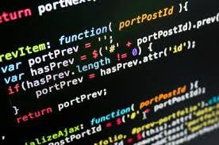
Computer Programming
Computer programming is the process of writing instructions that get executed by computers.
The instructions, also known as code, are written in a programming language which the computer can understand and use to perform a task or solve a problem.

Slide 5
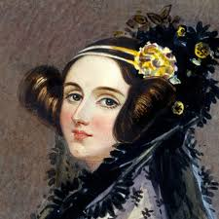
Ada Lovelace
Ada Lovelace has been called the world's first computer programmer.
What she did was write the world's first machine algorithm for an early computing machine that existed only on paper.

Slide 6
Programming Language (1)
A programming language is a vocabulary and set of grammatical rules for instructing a computer or computing device to perform specific tasks.
The term programming language usually refers to high-level languages, such as BASIC, C, C++, COBOL, Java, FORTRAN, Ada, and Pascal.

Slide 7
Programming Language (2)
It is a computer language engineered to create a standard form of commands.
These commands can be interpreted into a code understood by a machine.
Programs are created through programming languages to control the behavior and output of a machine through accurate algorithms, similar to the human communication process.
A programming language is also known as a programming system, computer language or computer system.

Slide 8
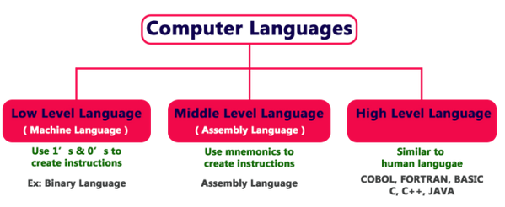
Levels of Programming Language

Slide 9
Middle Level Language
Is designed using some special words known as mnemonic and when we compared it to low level language, machine level is easy to understand.
This is the only language that is directly understood by the computer. It does not need any translator program.
This kind of languages is called assembly language.

Slide 10
Low Level Languages
The low-level language (LLL) is designed using zeros (0) and ones (1), hence they are critical to understand.
Instructions given to the computer in 0’s and 1’s is known as binary language or machine language.
Then programmers found writing code in binary language seems to be , then they used an English like words to write a program in order to understand and become easy and simple to code.

Slide 11
High level Language
These are designed using simple English like words.
Because of this, they are very easy to understand.
These are machine independent languages so they need to translator into machine level language.

Slide 12
In order to convert HLL to LLL we have 3 types of translator, which are:
Compiler: It converts the entire source code into object code (machine code) at once. Compilers are used to convert HLL into Machine code format.
Interpreter: It converts source code into object code in line-by-line format. It also used to convert HLL into understandable machine code.
Assembler: It is used to convert assembly level language (low level) into machine level language.

Slide 13
History of Programming Language
YEAR | Programming Language | DEVELOPER | LOCATION
1963 | CPL-Combined Programming Language | Members of University Mathematical of London & Cambridge | Cambridge University
1967 | BCPL -Basic Combined Programming Language | Martin Richards | Cambridge University
1958-68 | ALGOL - Algorithmic Language (Algol 58) | John Backus | Europe & US
 | ALGOL - Algorithmic Language (Algol 60) | Peter Naur | Europe & US
 | ALGOL - Algorithmic Language (Algol 68) | Van Wijngaarden | Europe & US
1970 | B | Ken Thompson | Bell Laboratory, US
1972 | C | Dennis Ritchie | Bell Laboratory, US
1980 | C++ | Bjarne Stroustrup | AT & T, US

Slide 14
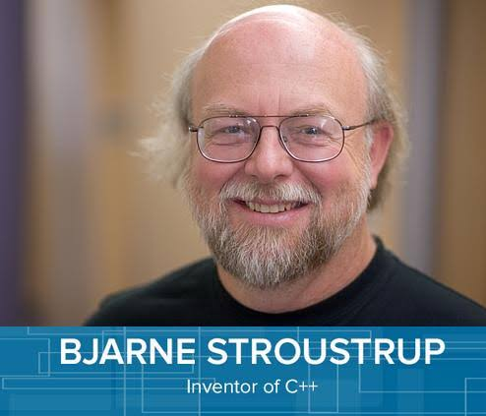
C++ (C with Classes)
Bjarne Stroustrup (B-yar-ne Strov-stroop)
Born 30 December 1950
A Danish computer scientist, most notable for the creation and development of the C++ programming language.
He is a visiting professor at Columbia University, and works at Morgan Stanley as a Managing Director in New York
He received a master's in mathematics from Aarhus University in 1975 and a PhD in computer science from Cambridge University in 1979.

Slide 15
C++
C++ is based on C and it retains much of that language, including a rich operator set.
C++ is a highly portable language, and translators for it exist on many different machines and systems.
C++ compilers are highly compatible with the existing C programs because maintaining such compatibility was a design objective.
Programming in C++ does not require a graphics environment, and C++ programs do not incur runtime expense from type checking or garbage collection.

Slide 16
C++ has improved on C in significant ways, especially in supporting strong typing.
The class syntax was added to the language which was an extension of the struct construct in C.
C++ is superior than C in supporting object-oriented programming. C++ may even replace C in becoming a general purpose programming language.

Slide 17
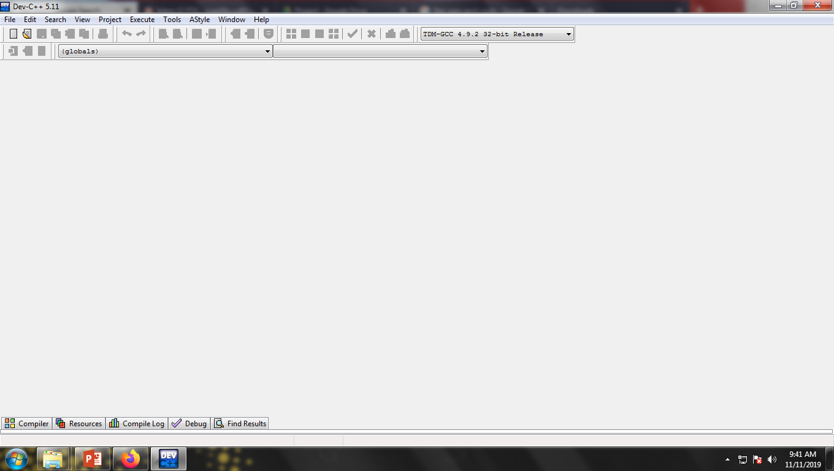
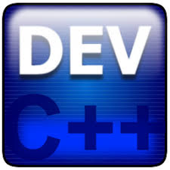
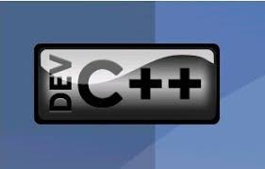
Dev C++

Slide 18
Source Code / Source File
WRITE
SAVE
COMPILE
RUN

Slide 19
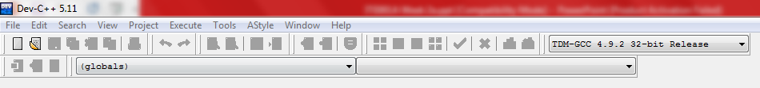
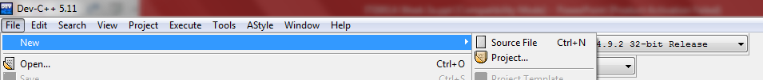

New Source File
CTRL + N

Slide 20
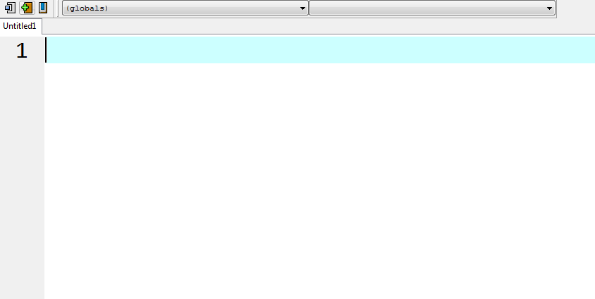
Workspace

Slide 21
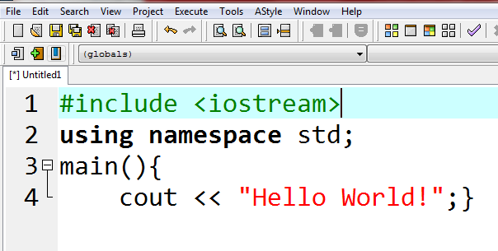
Write your first program.

Slide 22

Save, Compile and Run
Press F11

Slide 23
Try These…. C++ Codes
Program 1
#include <iostream>
using namespace std;
main(){
cout << "Hello World!";}
Modified Program 1
#include <iostream>
using namespace std;
main(){
cout << "Hello World! ";
system("pause");
}

Slide 24

Errors / Bugs

Slide 25
Try These…. C++ Codes
Program 2 : More Hello
#include <iostream>
using namespace std;
main(){
cout << "Hello World!";
cout << "Hello World!";
cout << "Hello World!";
cout << "Hello World!";}
Modified Program 2
#include <iostream>
using namespace std;
main(){
cout << "Hello World!“ << endl;
cout << "Hello World!" << endl;
cout << "Hello World!" << endl;
cout << "Hello World!" << endl;}

Slide 26
Write a program that will display your basic info.
Complete Name
Complete Home Address
Email Address
Program
Name of the School

Slide 27
Displaying Special Symbols… Do This…
#include <iostream>
using namespace std;
main(){
cout << "Display backslash: \\ " << endl;
cin.get();
cout << "Display double quote: \" " << endl;
cin.get();
cout << "Display single quote: \' " << endl;
cin.get();
cout << "Computer\nFundamentals\nand\nProgramming" << endl;
cin.get();
cout << "ITE001A\t\tIntroduction to Programming" << endl;
cin.get();
cout << "Printing Other Symbols: ! @ $ ^ & * () ? ; < > %"; }

Slide 28
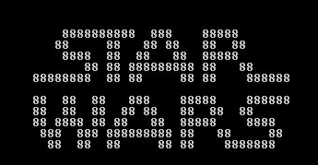
Do This for 20 mins (Max)

Slide 29

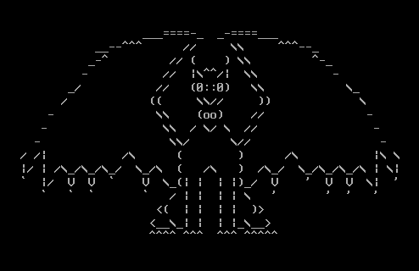
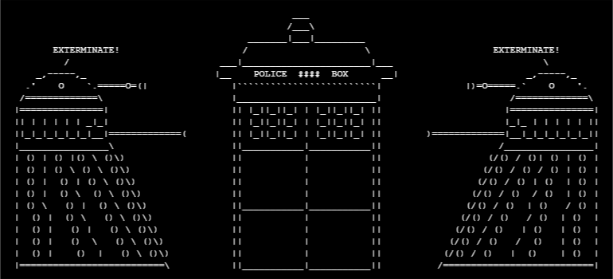
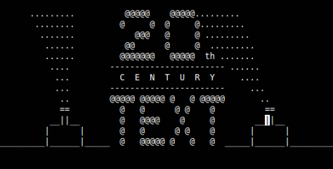

Slide 30
C++ Basics
The main function ‘main( )’ signals the beginning of the program. Obviously, there cannot be more than one main() function, otherwise the computer woudn’t know where to start.
{ }-The opening brace marks the beginning of the body of the function ‘main()’. The opposite brace is serves as the end of the body.
Semicolon or ; - Statement is a line of code in C and C++ terminated with a semicolon.
cout <<- output or display, it serves as an outputting command. This function is found in the standard library functions of C++ system.
<< endl – position the cursor to the next line instead of using \n.

Slide 31
Features
White Space
You will frequently see references to something called white space.
It is typically used to separate different words in a program.
White space consists of one or more space, tab ( \t) and newline(\n).
The judicious use of white space can make your programs much more readable.

Slide 32
Literal Constants
Literal Constants
Several characters have names that use a back slash notation which is useful when you want to embed one of these characters within a literal character string.
Some examples
Constants Name
\n New Line
\t Tab
\’ Single quotation mark
\” Double quotation mark
\0 Zero

Slide 33
Declarations
It is a characteristic of many computer languages that variables must be declared before they can be used.
A variable declaration gives a name to the variable, and tells the computer what type of data this variable can hold.

Slide 34
Variable Declaration
A declaration of a variable is where a program says that it needs a variable.
For our small programs, place declaration statements between the two braces of the main method.
The declaration gives a name and a data type for the variable.
DataType VariableName;
It may also ask that a particular value be placed in the variable.
DataType VariableName = InitialValue;

Slide 35
Data Type
Number
Integer – Whole Number
Floating Point
Float – numbers with up to 6 decimal places
Double – numbers beyond to 6 decimal places
Character
Character – Single letter or any character enclosed with a single quote
String – combination of alphanumeric values enclosed with a double quote
Boolean
True or False
A data type or simply type is an attribute of data which tells the compiler or interpreter how the programmer intends to use the data.

Slide 36
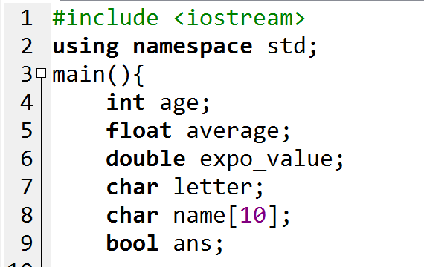
Using the data type
DataType VariableName;

Slide 37
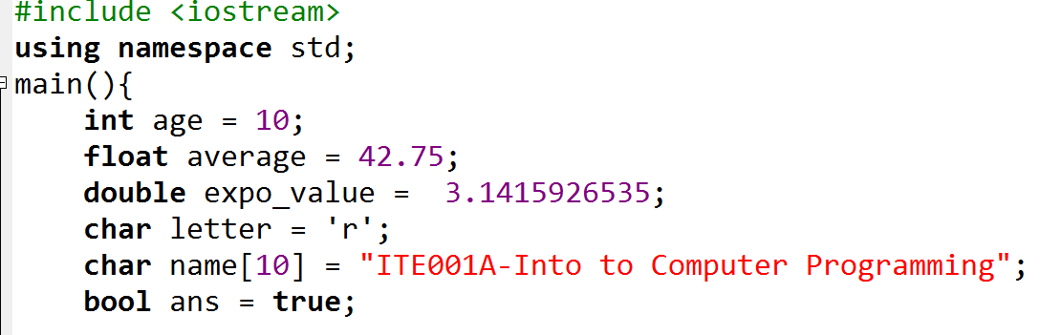
Using the data type
DataType VariableName = Value;

Slide 38
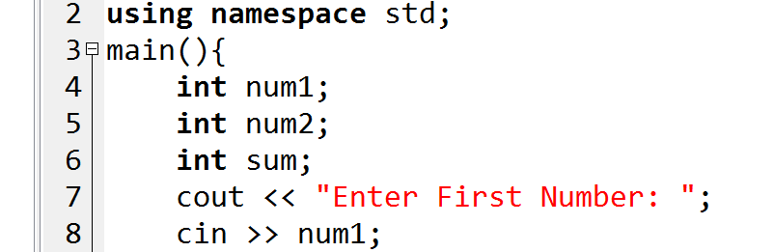
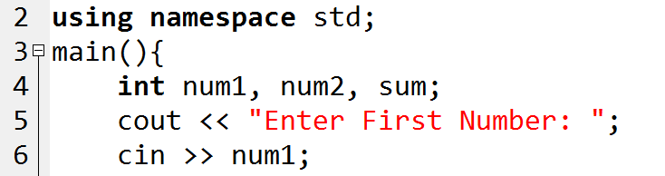
Variable Declaration

Slide 39
Variable
a variable is a storage location (identified by a memory address) paired with an associated symbolic name (an identifier), which contains some known or unknown quantity of information referred to as a value
Examples:
X, XY, name, NUMBER, SAMPLE1, sample2, First_name
FirstName, Sample1, sample1, sAMPLE1

Slide 40
Identifier/ Variable Declaration Rules
A sequence of one or more letters, digits, or underscore characters (_).
Spaces, punctuation marks, and symbols cannot be part of an identifier.
Shall always begin with a letter.
No case can they begin with a digit.
Max 8 chars or depend on compiler and OS
Always exist in the left hand side of assignment operator
No keyword for a variable name

Slide 41
Keywords - a word that is reserved by a program because the word has a special meaning.
List of C++ keywords: alignas, alignof, and, and_eq, asm, auto, bitand, bitor, bool, break, case, catch, char, char16_t, char32_t, class, compl, const, constexpr, const_cast, continue, decltype, default, delete, do, double, dynamic_cast, else, enum, explicit, export, extern, false, float, for, friend, goto, if, inline, int, long, mutable, namespace, new, noexcept, not, not_eq, nullptr, operator, or, or_eq, private, protected, public, register, reinterpret_cast, return, short, signed, sizeof, static, static_assert, static_cast, struct, switch, template, this, thread_local, throw, true, try, typedef, typeid, typename, union, unsigned, using, virtual, void, volatile, wchar_t, while, xor, xor_eq

Slide 42
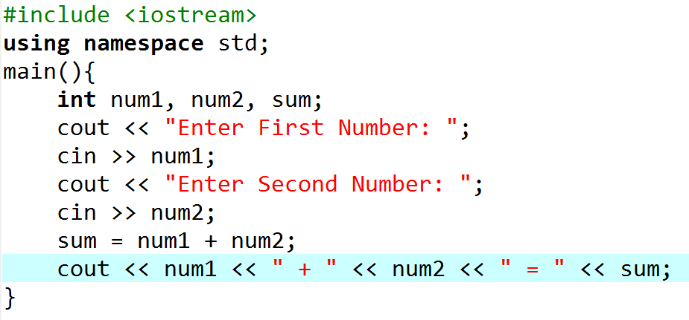
Try this…

Slide 43
Try this…
Change this to float

Slide 44
Features
Comments
// and /*....*/ comments in C++ could be used for representing remarks.
End-of-line Comments //
Everything on the program line to the right of the // characters is ignored and removed by the preprocessors.
One benefit of these comments is the ability to place them within a block style comment.
Since block style comments cannot be nested, these comments offer the ability to nest comments within comments.

Slide 45
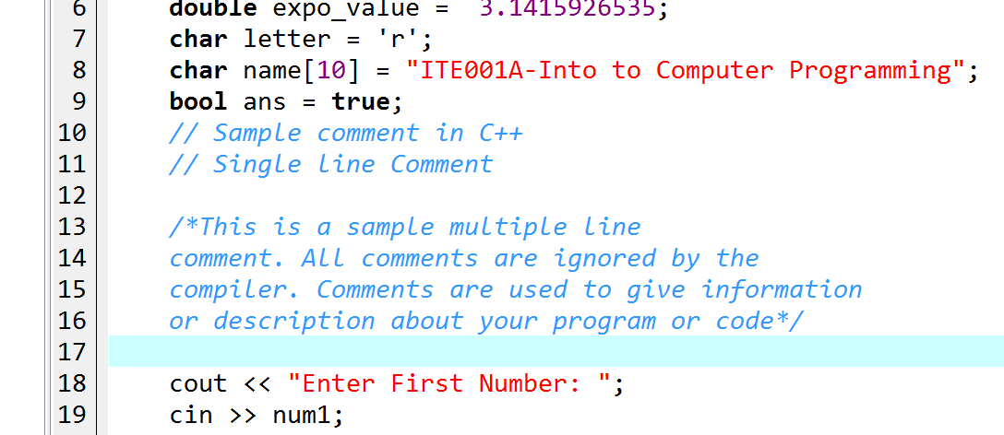

Slide 46
Common programming problems
Same identifiers are used with different letter formats.
C++ is case sensitive. It distinguishes between uppercase and lowercase characters.
Identifiers are predefined keywords in C++.
Programmers should be careful in defining identifiers. They should, as far as possible, be meaningful.

Slide 47
Common programming problems
Working with blocks
C++ is a block structured language.
Blocks are defined as: { }.
Blocks are generally used when there are more than one instructions to be executed at a point of condition checking.

